Slide 1
Statistical Analysis
Another type of problem

Slide 2
Question
Qmyra | June | December
Yes | 50 | 60
No | 450 | 440
Has my market share changed?

Slide 3
And yet another problem
 |  | Response
Area type | Improved | Disimproved | No Change
Urban | 320 | 215 | 65
Rural | 235 | 110 | 55
Is there a relationship between area type and response?

Slide 4
First problem
Qmyra | June | December | Total
Yes | 50 | 60 | 110
No | 450 | 440 | 890
Total | 500 | 500 | 1000
Market share for June 50/500 = 10%
Market share for December = 60/500=12%

Slide 5
2 x 2 tables
500 people randomly selected in June
A different 500 people randomly selected in December
Look at this as a test of proportions
Frequency data
Works for all size tables
2 approaches – hypothesis testing and confidence interval for difference in proportions

Slide 6
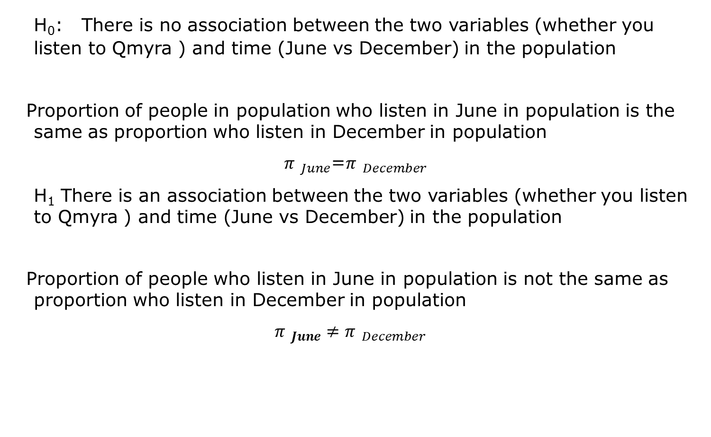
Hypothesis test
H₀: There is no association between the two variables (whether you listen to Qmyra ) and time (June vs December) in the population
Proportion of people in population who listen in June in population is the same as proportion who listen in December in population
${π }_{June}$=${π }_{December}$
H₁ There is an association between the two variables (whether you listen to Qmyra ) and time (June vs December) in the population
Proportion of people who listen in June in population is not the same as proportion who listen in December in population
${π }_{June}{≠π }_{December}$

Slide 7
First step
What would we expect to get if the null hypothesis were true?
Overall 110/1000=11% people listened to QMyra
If there was no difference between June and December we would expect 11% to listen at each time
In the June group - 11% of 500= 55
In the December group – 11% of 500= 55
Qmyra | June | December | Total
Yes | 50 | 60 | 110
No | 450 | 440 | 890
Total | 500 | 500 | 1000

Slide 8
Expected Values
Similarly, we can work out the expected values for the other two cells - those that did not listen to Qmyra
Expected Values =

Slide 9
Expected Values
 | Expected Values
Qmyra | June | December
Yes | 55 | 55
No | 445 | 445
 | Observed Values
Qmyra | June | December
Yes | 50 | 60
No | 450 | 440

Slide 10
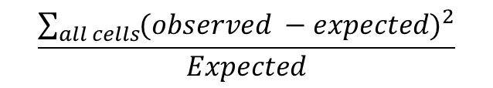
How do we compare them?
How do we compare them?
What do we consider a difference?
Statistical theory to help us do this
This will be big if observed values differ from expected values
We then have to have a method of deciding how big is big?
$$\frac{\sum_{all cells}{{(observed −expected)}^{2}}}{Expected}$$

Slide 11
Chi-square test (χ²)
Provides us with a method of deciding whether observed and expected values are different enough.
New table
Just another theoretical distribution
The last one for this course

Slide 12
Calculations
= 0.455+0.455+0.056+0.056
= 1.021
df = (number of rows - 1) * (number of columns - 1)
= (2-1)*(2-1) = 1
Is this difference big enough?

Slide 13
A new table of critical values
 | Chi-Square table
 | α - significance level
df | 0.05 | 0.025 | 0.001
1 | 3.84 | 5.02 | 10.83
2 | 5.99 | 7.38 | 13.82
3 | 7.81 | 9.35 | 16.27
4 | 9.49 | 11.14 | 18.47
5 | 11.07 | 12.83 | 20.52
6 | 12.59 | 14.45 | 22.46
7 | 14.07 | 16.01 | 24.32
8 | 15.51 | 17.53 | 26.12
9 | 16.92 | 19.02 | 27.88
10 | 18.31 | 20.48 | 29.59
α = .05
df= 1 : critical value = 3.84

Slide 14
What do we do now?
Values > 3.84 – evidence against H₀
Values <= 3.84 – not enough evidence against H₀
We got 1.021; no evidence against H₀
There was no evidence to suggest a change in market share.

Slide 15
Confidence Interval for difference in proportions
95% CI for difference in population proportions
=(p_{Dec}-p_{June})±t _{crit}*SE(p_{Dec}-p_{June})
t_{crit} t-tables with n₁+n₂-2 df = 500+500-2=998
We can use 1.96 here
We need to know now what the SE for the difference in proportions is

Slide 16
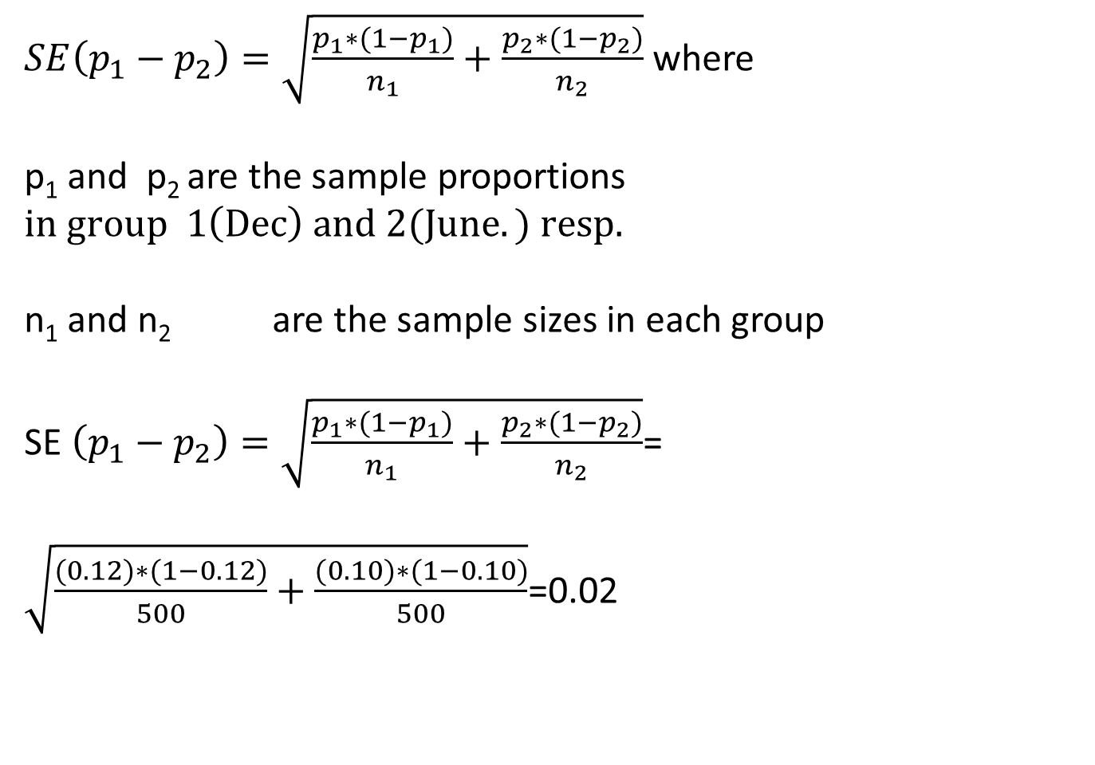
SE (difference in proportions)
$SE\left(p_{1}−p_{2}\right)=\sqrt{\frac{p_{1}∗(1−p_{1})}{n_{1}}+\frac{p_{2}∗(1−p_{2})}{n_{2}}}$ where
p₁ and p₂ are the sample proportions $in group 1\left(Dec\right) and 2(June.) resp.$
n₁ and n₂ are the sample sizes in each group
SE $\left(p_{1}−p_{2}\right)=\sqrt{\frac{p_{1}∗(1−p_{1})}{n_{1}}+\frac{p_{2}∗(1−p_{2})}{n_{2}}}$=
$\sqrt{\frac{(0.12)∗(1−0.12)}{500}+\frac{(0.10)∗(1−0.10)}{500}}$=0.02

Slide 17
CI
=(p_{Dec}-p_{june})±1.96*SE(p_{Dec}-p_{june})
= 0.02±1.96*0.02 = 0.02 ±0.04 = -0.02 to 0.06
The negative end of his interval means that market share in June > market share in December.
The positive end scale means that market share in December > market share in June
0 in interval – no evidence of difference between populations market shares

Slide 18
Some added cautions
80% of the expected values > 5
All 4 expected values were greater than 5
Importance of confidence interval
Gives estimate of effect
Minitab will print out p-value of the test and expected values

Slide 19
Other Problem
 |  | Response
Area type | Improved | Disimproved | No Change | Total
Urban | 320 | 215 | 65 | 600
Rural | 235 | 110 | 55 | 400
Total | 555 | 325 | 120 | 1000

Slide 20
Another way of looking at it
 |  | Rating
Area type | Improved - % | Disimproved % | No Change % | Total %
Urban | 58 | 66 | 54 | 60
Rural | 42 | 34 | 46 | 40
N's | 555 | 325 | 120 | 1000

Slide 21
And another
 |  | Rating
Area type | Improved | Disimproved | No Change | Total
Urban % | 53 | 36 | 11 | 600
Rural % | 59 | 28 | 14 | 400
Total | 56 | 33 | 12 | 1000

Slide 22
And yet again …
 | Area type
Rating | Urban % | Rural % | Total
Improved | 53 | 59 | 56
Disimproved | 36 | 28 | 33
No Change | 11 | 14 | 12
N’s | 600 | 400 | 1000

Slide 23
Hypothesis formulation
H_{0:} There is no relationship between type of area and response in population
H_{1:} There is a relationship between type of area and response in population

Slide 24
Minitab Results prettied up
 | Improved | Disimproved | No Change | Total
Urban – Obs. | 320 | 215 | 65 | 600
Expected | 333 | 195 | 72
Contribu. | 0.508 | 2.051 | 0.681
Rural – Obs | 235 | 110 | 55 | 400
Expected | 222 | 130 | 48
Contrib. | 0.761 | 3.077 | 1.021
Total | 555 | 325 | 120 | 1000
Chi-Sq=0.508+2.051+0.681+0.761+3.077+1.021
Chi-Sq = 8.098, DF = 2, P-Value = 0.017

Slide 25
Points to note
df= 2
(no. of rows -1 ) * (no. of cols -1)= 2*1=2
As p-value < 0.05 we have sufficient evidence to reject H₀
There is a relationship between area type and rating.
We cannot say much more here.

